Slide 1
Figures and Tables The Results section: part 1
Fish 290

Slide 2
Reading
We will spend the next 3 class periods on the Results section, including figures and tables.
Our time in class is limited.
The readings on Canvas* are chosen to fill in gaps we might not cover in class.
*readings from The Scientist’s Guide to Writing by Stephen Heard

Slide 3
Presentation of Results:
Three complementary approaches
Today’s agenda:
When to use a figure, table, or neither?
What options do I have for figures?
How to make an effective figure or table?

Slide 4
Presentation of Results:
Three complementary approaches
Text: We state in words what we found - what happened.
We will cover text in more detail later
Figures: Graphs help visualize complex relationships and draw the reader’s attention to the most important findings.
Tables: Provide details on the results that are important
Most journals encourage “supplemental” or “appendix” tables for more details. Journals also encourage electronic storage of raw data for public access (this is a new feature of science).
For your studies, including raw data as a table is Fine.

Slide 5
Presentation of Results:
Three complementary approaches
Not every result needs a figure or table. Too many graphics will dilute your main points and confuse your reader. If everything is important than nothing is.
When do I use a figure?
When do I use a table?
When do I not bother with either and just write a sentence?

Slide 6
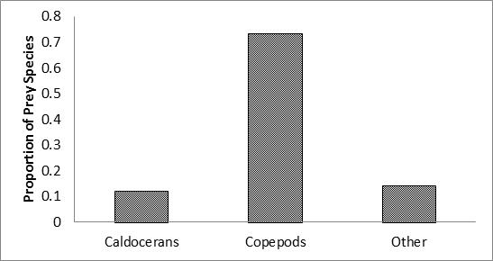
When to use just a sentence:
Remember that graphics compete for your reader’s attention. Use a sentence or two for simple results with few numbers.
How many data points are shown in this figure?

Slide 7
When to use just a sentence:
Remember that graphics compete for your reader’s attention. Use a sentence or two for simple results with few numbers.
“Copepods comprised the highest proportion of prey items (75%). Caldocerans comprised 12% of prey items, and the remaining 13% of items were unidentified.”
Do you need a figure to understand this result?

Slide 8
When to use a graphic (either figure or table):
Try this sentence on for size:
“For lakebottom sediments collected at the inflow, average grain size was 1.3 mm (± 0.4 mm standard deviation). Smaller grains predominated farther out: average 0.8 mm (± 0.2 mm) at 5 m from the inflow, 0.2 mm (± 0.004 mm) at 40 m, and 0.002 mm (± 0.0005 mm) at 60 m.”
UGH SO COMPLICATED!!!!

Slide 9
When to use a graphic (either figure or table):
Try this sentence on for size:
“For lakebottom sediments collected at the inflow, average grain size was 1.3 mm (± 0.4 mm standard deviation). Smaller grains predominated farther out: average 0.8 mm (± 0.2 mm) at 5 m from the inflow, 0.2 mm (± 0.004 mm) at 40 m, and 0.002 mm (± 0.0005 mm) at 60 m.”
Numbers are inherently demanding to read.
Use a graphic to display complicated relationships or numerical information.

Slide 10
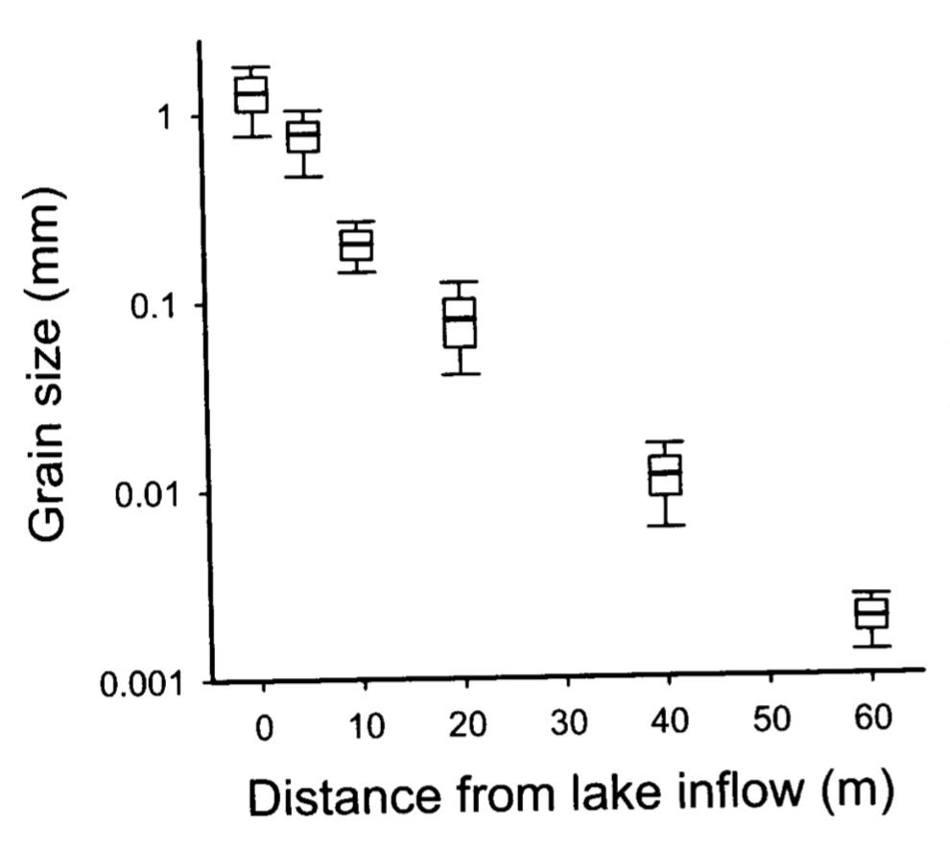
When to use a graphic (either figure or table):
“Grain size was large at the inflow and decreased farther out (Fig. 1).”
A breath of fresh air!

Slide 11
When to use a Figure versus a Table
Figures are best at showing relationships and trends.
However, tables are good at showing precise numbers and multiple variables at once.
Think: what do I want the reader to take away from this graphic?
If it’s a trend (an increase or decrease) or a relationship (two variables interact) then use a figure.
If it’s the exact value (like a p-value) and there are too many entries for one sentence, then use a table.

Slide 12
When to use a Figure versus a Table
Figures are best at showing relationships and trends.
However, tables are good at showing precise numbers and multiple variables at once.
Think: what do I want the reader to take away from this graphic?
If it’s a trend (an increase or decrease) or a relationship (two variables interact) then use a figure.
If it’s the exact value (like a p-value) and there are too many entries for one sentence, then use a table.

Slide 13
Presentation of Results:
Three complementary approaches
Today’s agenda:
When to use a figure, table, or neither?
What options do I have for figures?
How to make an effective figure or table?

Slide 14
Types of figures: scatterplots
Attributes:
Shows relationship between data
Independent data (x axis) influences dependent data (y axis)
Good when both variables are continuous data
Can show trends
Shows exact data points, not summary statistics (what is a summary statistic?)
Warnings:
Both variables MUST be continuous
Make sure multiple series on graph are comparable
Do not have too many different data sets
Notes:
let’s walk though some examples of plots that we might use

Slide 15
Types of figures: line plots
Attributes:
Good if one variable is continuous and one is numerical but discrete (e.g. time)
Can compare multiple series of data
Suggests values between data points
Patterns are readily apparent
Warnings:
Data must be continuous!
For each line, one datum per observation
Intermediate values must be valid
Poor choice if few data points
Make sure multiple series on graph are comparable (same scale)

Slide 16
Types of figures: bar graphs
Numbers of fish caught per year in commercial fisheries in the Atlantic, Pacific, and Indian oceans.
Attributes:
Each bar represents a discrete data point
Patterns are visually striking
The order of the bars can reveal patterns
Can compare categories
Warnings:
Not great for continuous data
May not reveal variation around the mean or bar value
Bars order can suggest false trends
Takes up a lot of space to show a few data points- use wisely

Slide 17
Types of figures: boxplots (box and whisker)
Boxplots: shows data spread including median, quartiles and outliers
Attributes:
Bars show variation, including summary statistics
Patterns are visually striking
The order of the bars can reveal patterns
Can compare categories
Warnings:
Bars order can suggest false trends
“whiskers” can mean different things (standard deviation, vs quartiles vs. total range, etc.)

Slide 18
Other types of figures to consider
Maps, photographs, or flowcharts: Usually does not show data or results. Instead, used to give the reader a sense of what you did (Methods)
Histogram: uses bars to show counts of one variable.
Pie chart*: shows proportions of a whole
* The case for/against pie charts: https://www.geckoboard.com/blog/pie-charts/

Slide 19
Presentation of Results:
Three complementary approaches
Today’s agenda:
When to use a figure, table, or neither?
What options do I have for figures?
How to make an effective figure or table?

Slide 20
Making effective figures
There are many possible ways to display the same result.
Just because a program can make it,
doesn’t mean it’s correct or the best option.
The golden rule of figures and table design:
Give readers the most information capable of being digested in the shortest time with the least ink in the smallest space possible.

Slide 21
Making effective figures
Critique the following figures. Avoid critiquing captions for now (we’ll come back to that)

Slide 22
Making effective figures
Graph showing average prey proportions in Lake Washington. Calculated from data collected from 1993-2011.

Slide 23
Making effective figures
Graph showing average prey proportions in Lake Washington. Calculated from data collected from 1993-2011.
Critique: This figure contains only three data points: the proportions of the three prey species. This can easily be expressed in a single sentence.

Slide 24
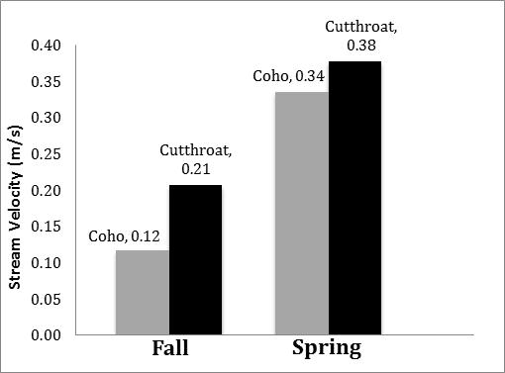
Making effective figures
Average stream velocity of habitat where fish were captured in Rock Creek

Slide 25
Making effective figures
Average stream velocity of habitat where fish were captured in Rock Creek
Critique: Better, but the figure has the data in numerical form and this is redundant with the height of the bars. In addition, there is no indication of variation around the means.

Slide 26
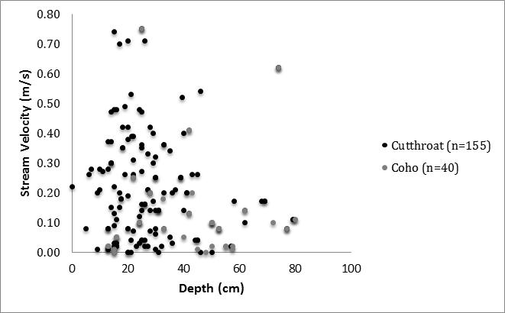
Stream velocity vs. depth of habitat occupied by captured fish in Rock Creek (fall)

Slide 27
Stream velocity vs. depth of habitat occupied by captured fish in Rock Creek (fall)
Critique: This is better, but the two sets of points need more distinct symbols to tell them apart.

Slide 28
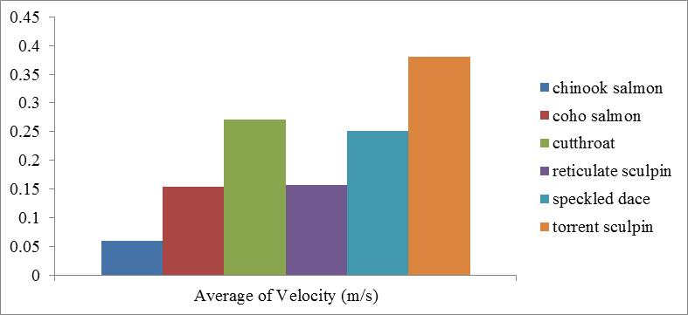
Making effective figures
The average velocity (m/s) of where the instream species were found.

Slide 29
Making effective figures
The average velocity (m/s) of where the instream species were found.
Critique: The x-axis has the label that belongs on the y-axis. Why are the species listed in this order? It is alphabetical but so what? What is the message here? Also, no variation among means shown.

Slide 30
Making effective figures
The figures you just saw violate parts of the golden rule:
Give readers the most information* capable of being digested in the shortest time with the least ink in the smallest space possible.
*incorrect information doesn’t count.
Do not mislead!

Slide 31
Assignments for today and for home
In class:
Work on some data to get used to making graphs in Excel / R
Draw out ideas for figures and tables for your own data
Make figures and tables for your own data
Work on peer reviews
At home:
Read “The Results Section” on Canvas
Continue data analysis/graphics on your own
Complete peer reviews by end-of-day Wednesday
Continue working on your Intro+Methods (Methods due Friday)
Next time in class, we will cover Tables and Captions.

